Slide 1
Car accident severity Classifier
Kwak Hyunwoo

Slide 2
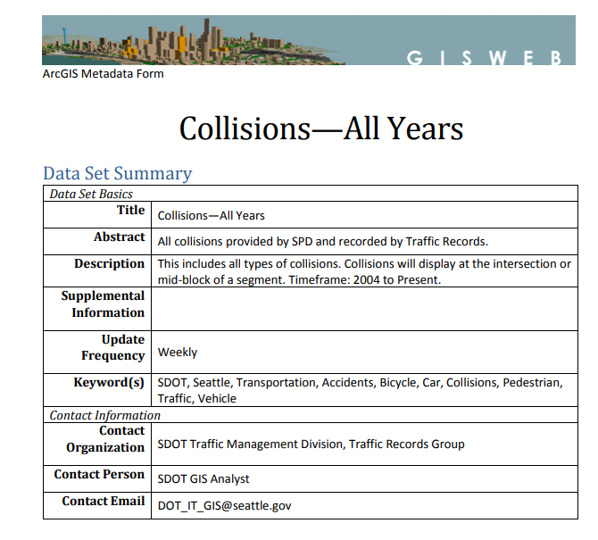
Collision Data
From Coursera
2. Dataset

Slide 3
X_DATA
'SEVERITYCODE’
'OBJECTID’,
'INCKEY’
'COLDETKEY’,
'REPORTNO’,
'STATUS’
'EXCEPTRSNDESC’
…
X_DATA
'SEVERITYCODE’
'OBJECTID’,
'INCKEY’
'COLDETKEY’,
'REPORTNO’,
'STATUS’
'EXCEPTRSNDESC’
…
One-Hot Encoding
Time Series Data Processing
elimination of missing values
Extract
Y_DATA
SEVERITYCODE
3-1. Data Preprocessing

Slide 4
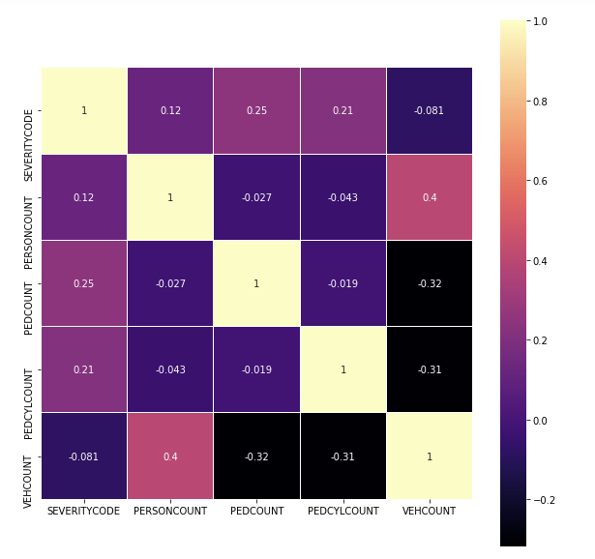
Heatmap
Between Features’ correlation
3-2. Data Visualization

Slide 5
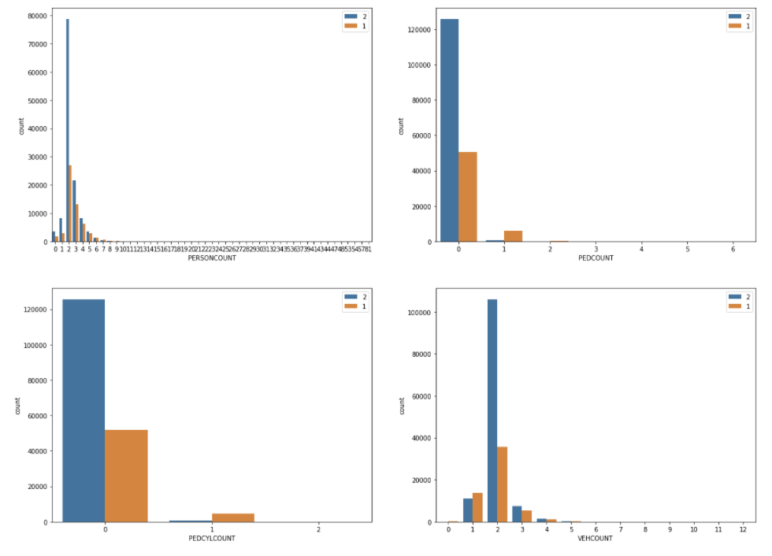
Count plot
of collision severity according to number of persons involved
3-2. Data Visualization

Slide 6
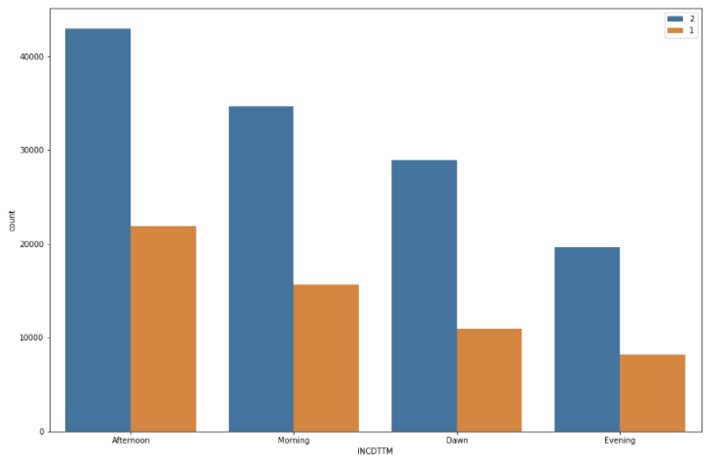
Count plot
of collision severity according to number of persons involved
3-2. Data Visualization

Slide 7
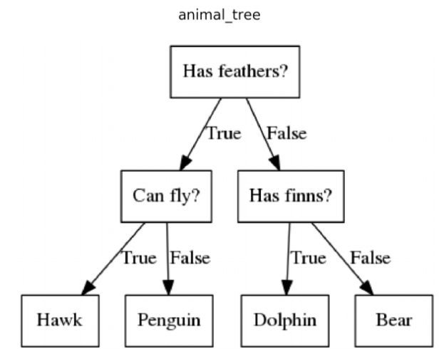
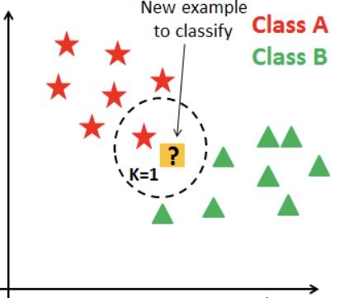
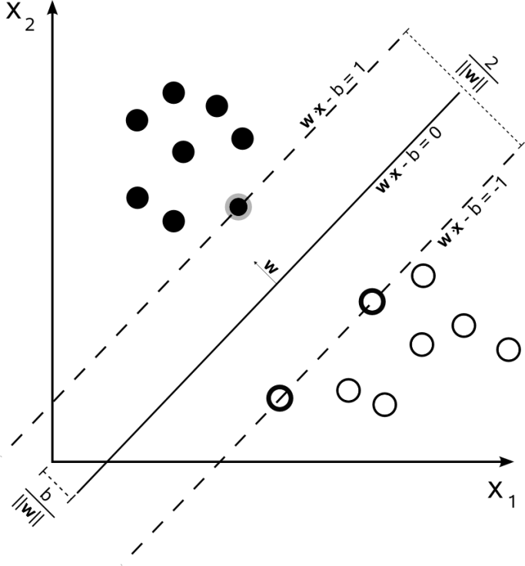
Models that I use
SVM
(Support Vector Machine)
Decision Tree
KNN(K-Nearest Neighbors)
3-3. Modeling

Slide 8
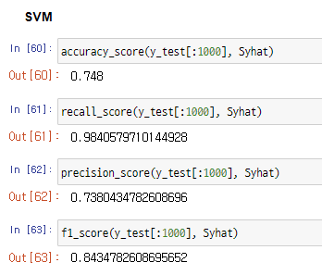
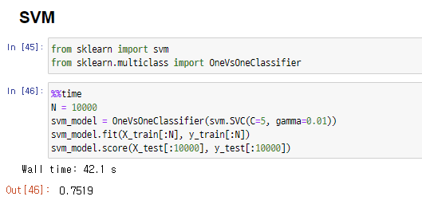
SVM
Modeling code
SVM
Evaluation
3-3. Modeling– Support Vector Machine

Slide 9
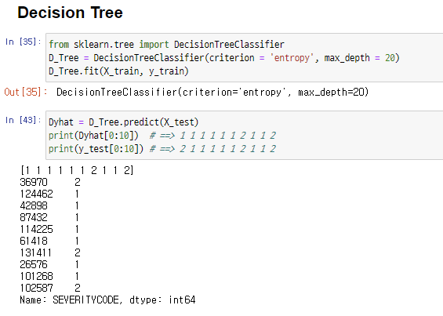
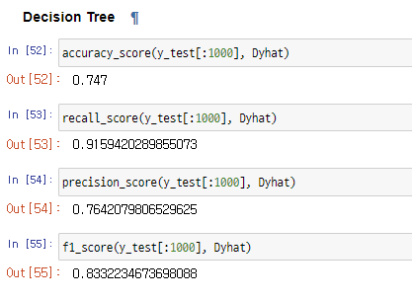
Decision Tree
Modeling code
Decision Tree
Evaluation
3-3. Modeling– Decision Tree

Slide 10
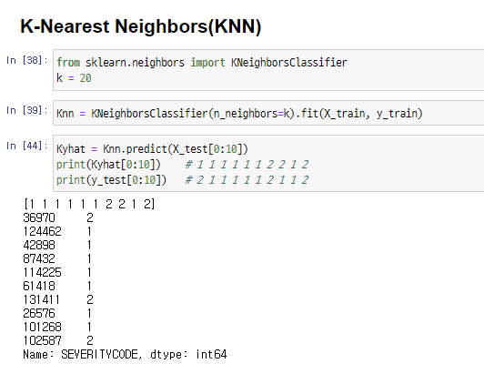
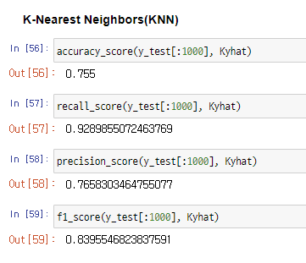
KNN
Modeling code
KNN
Evaluation
3-3. Modeling– KNN Algorithm

Slide 11
SVM: about 74.8%
Decision Tree: about 74.7%
KNN: about 75.5%
Accuracy not enough to be used as a model
How could I get better accuracy?
1
Training with more data
2
Hyper-Parameter Tuning
3
Using More Features
4. Conclusion

Slide 12
Thank You

